Slide 1

Hand Gesture Recognition System
-By
Aditya Chaudhary

Slide 2
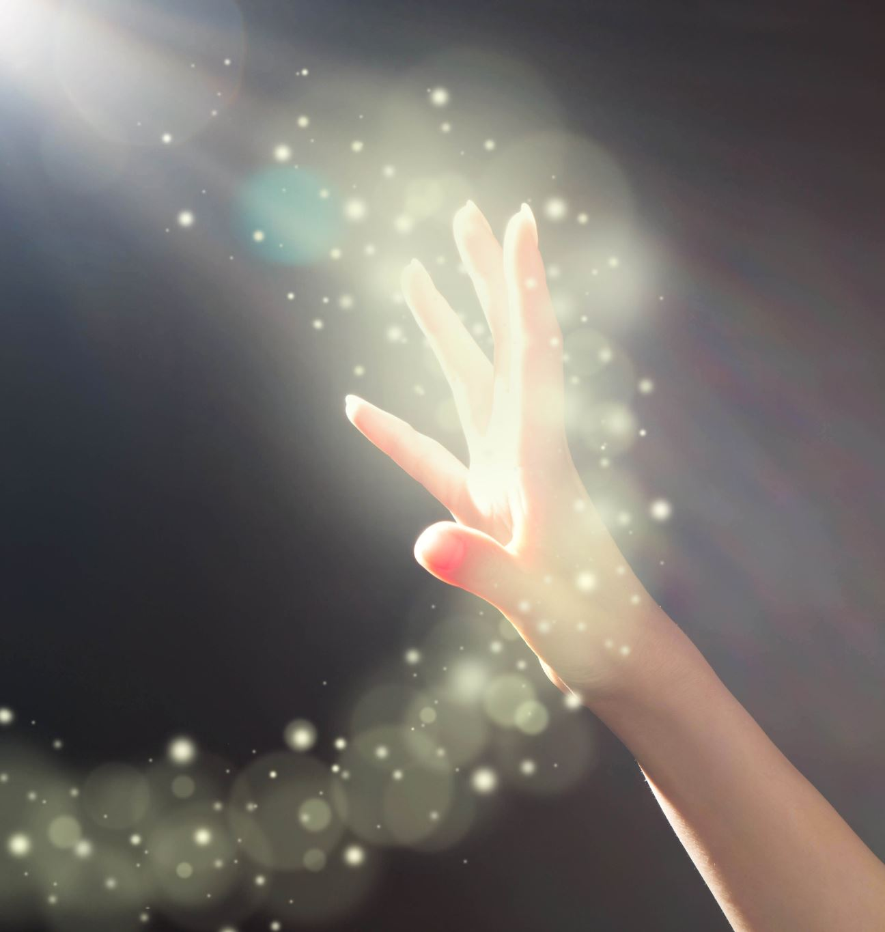
Agenda
Introduction
Problem Statement
Solution Approach
Model Architecture
Working of Hand Gesture Recognition System
Applications of Hand Gesture Detection
Key Points
Steps to solve the project
Hand Gesture Recognition System Output

Slide 3
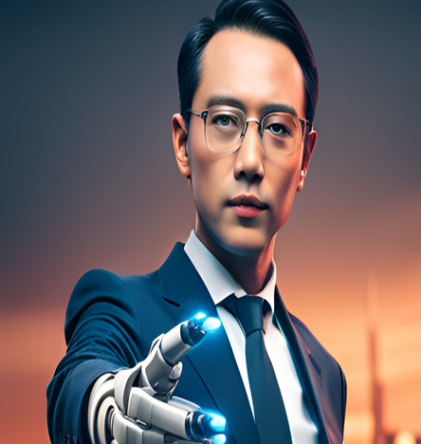
Introduction
Gesture recognition is the ability of a computer to understand human gestures as commands.

Slide 4
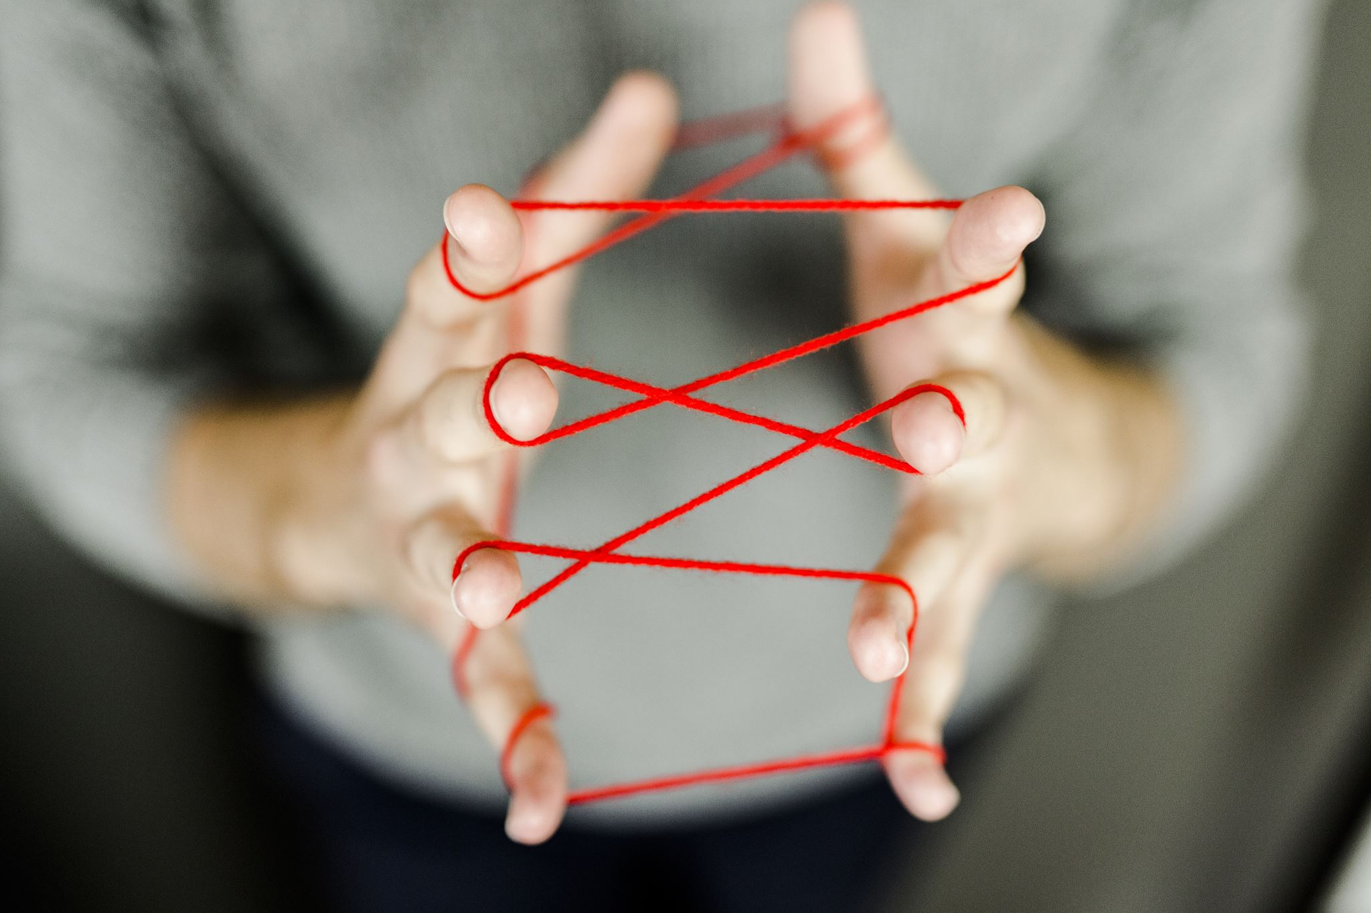
Problem Statement
Dealing with the variability and diversity of hand shapes and sizes.

Slide 5


Solution Approach
The proposed solution for hand gesture recognition involves leveraging the power of TensorFlow.js, keras ,cv2, and Mediapipe, to develop a robust and user-friendly system.

Slide 6

Model Architecture
Dataset Preparation
Architecture Design
Training
Model Evaluation
Testing and Deployment

Slide 7
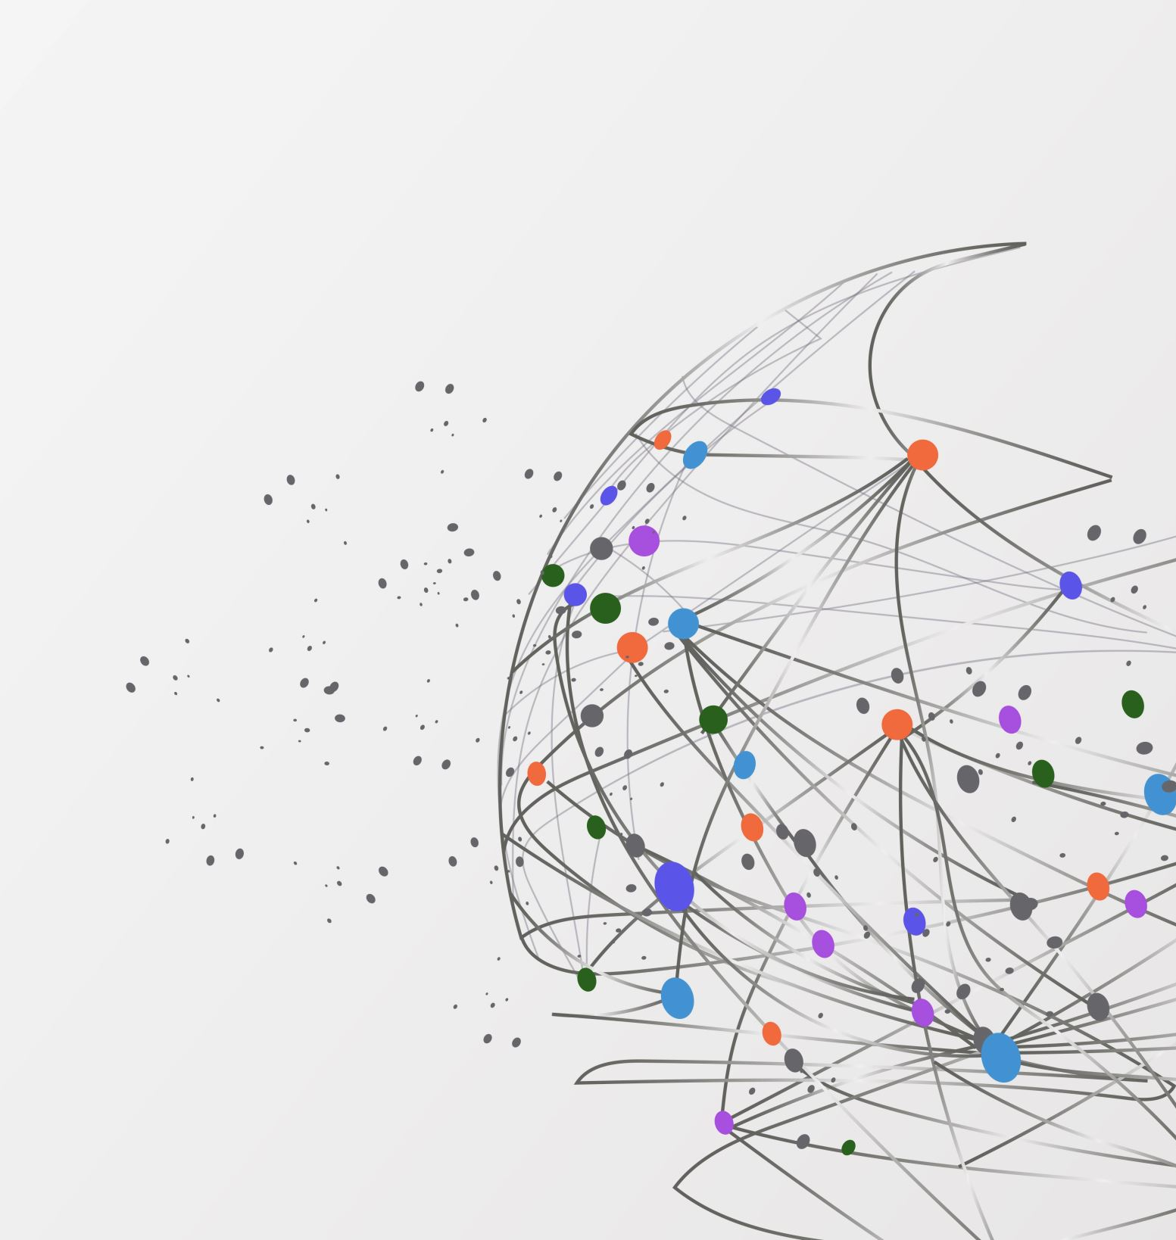
Working of Hand Gesture Recognition

Slide 8
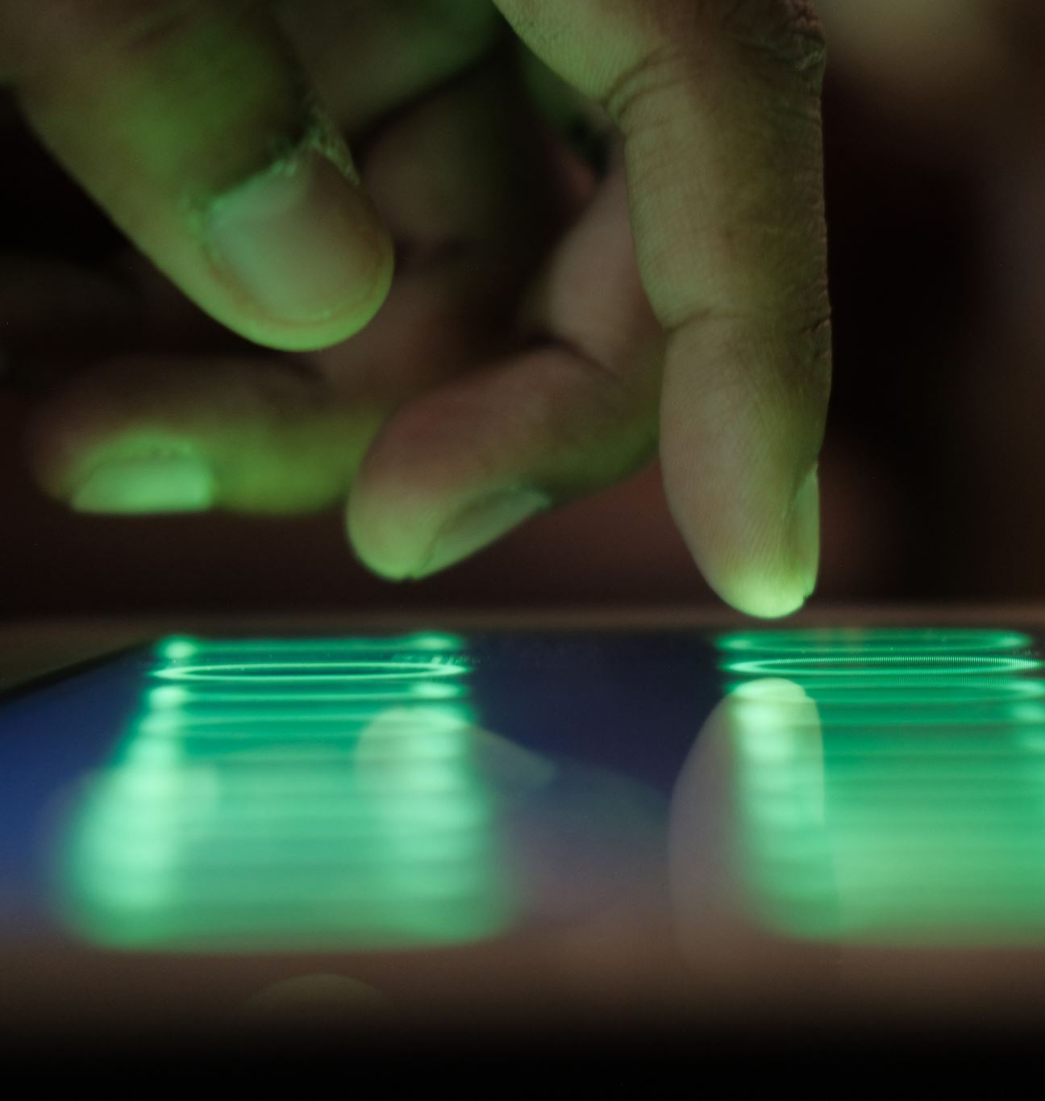
Applications of Hand Gesture Detection
Talking to computer
In the gaming industry
In virtual reality
In healthcare
Security and Surveillance
Hand gesture to control the home applications

Slide 9
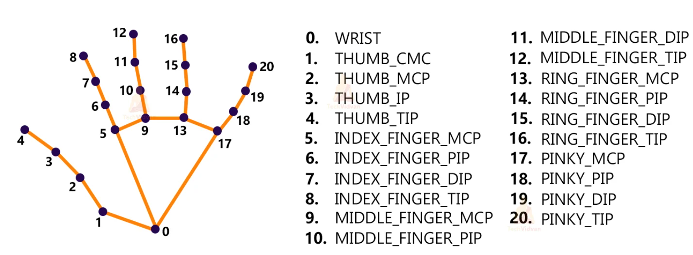
Key Points

Slide 10
Steps to solve the project
Import necessary packages.
Initialize models.
Initialize Tensorflow
Read frames from a webcam.
Detect hand keypoints.
Recognize hand gesture

Slide 11
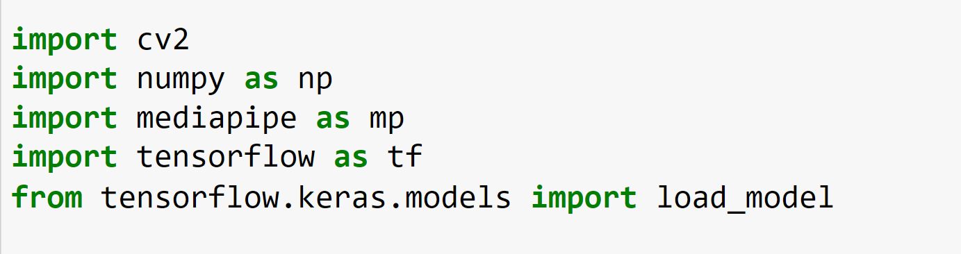
Import Necessary Packages.

Slide 12
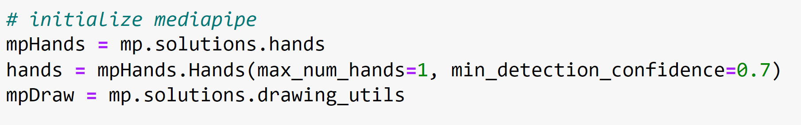
Initialize models.

Slide 13
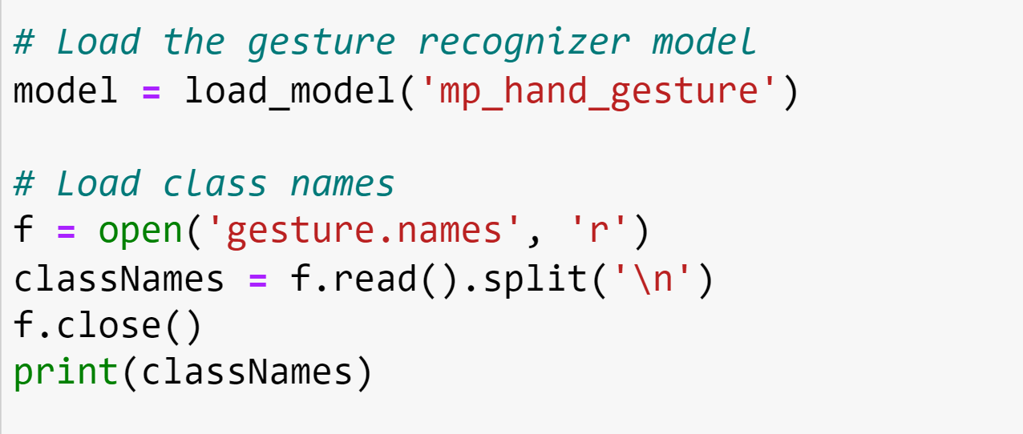
Initialize Tensorflow:
Output
Output

Slide 14
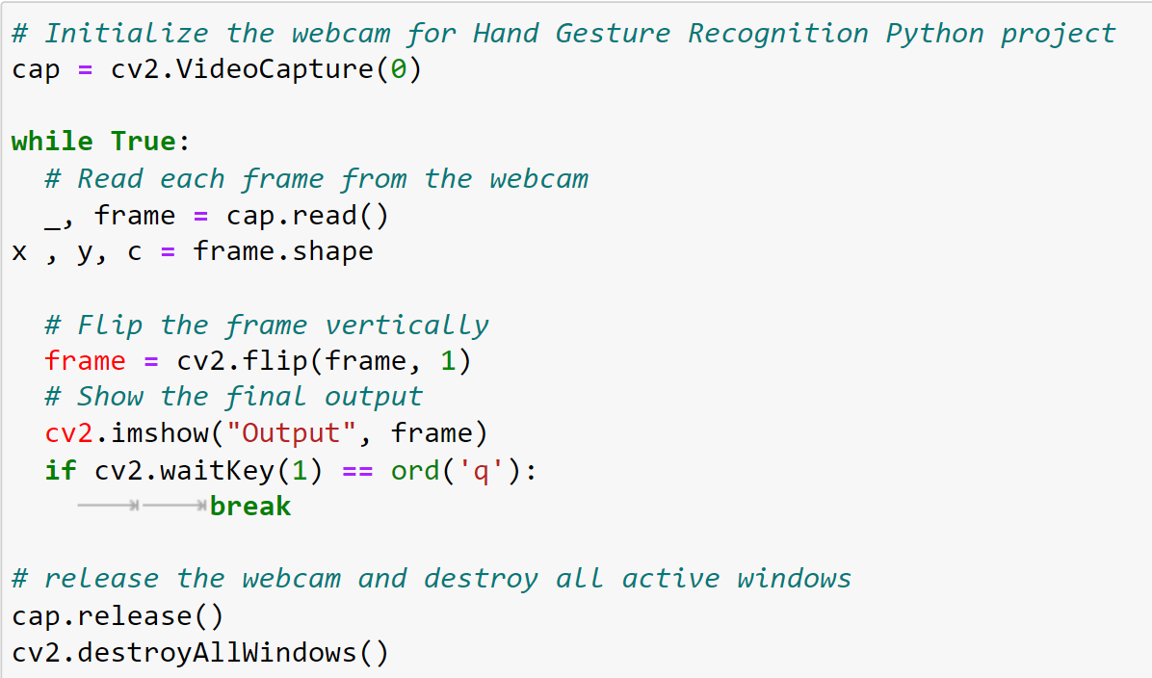
Read frames from a webcam:

Slide 15
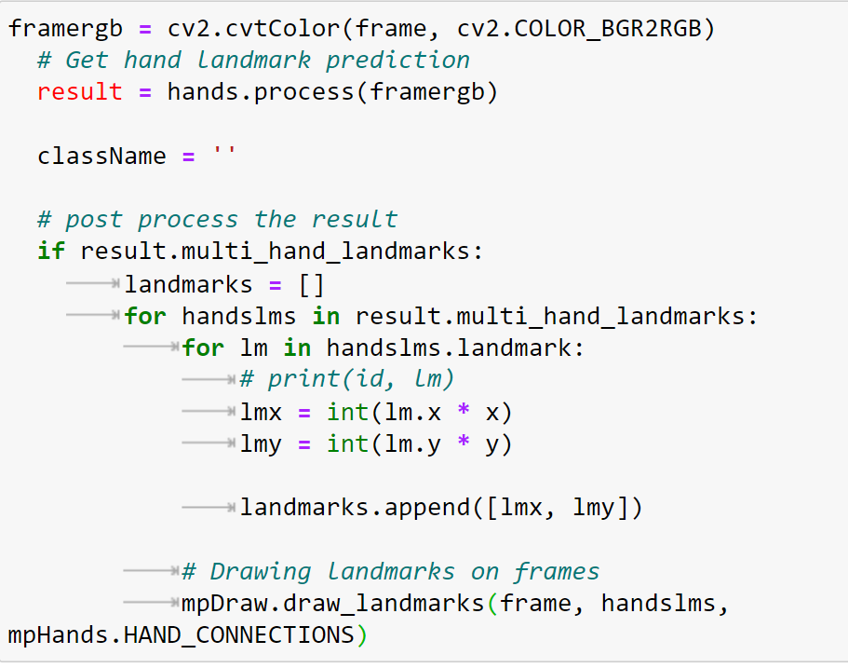
Detect hand keypoints:

Slide 16
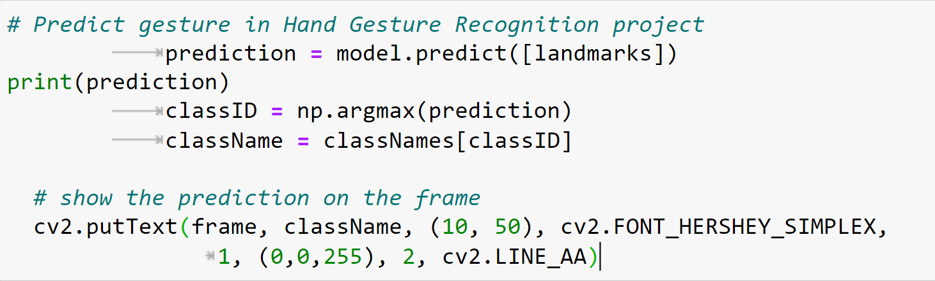
Recognize hand gestures:

Slide 17
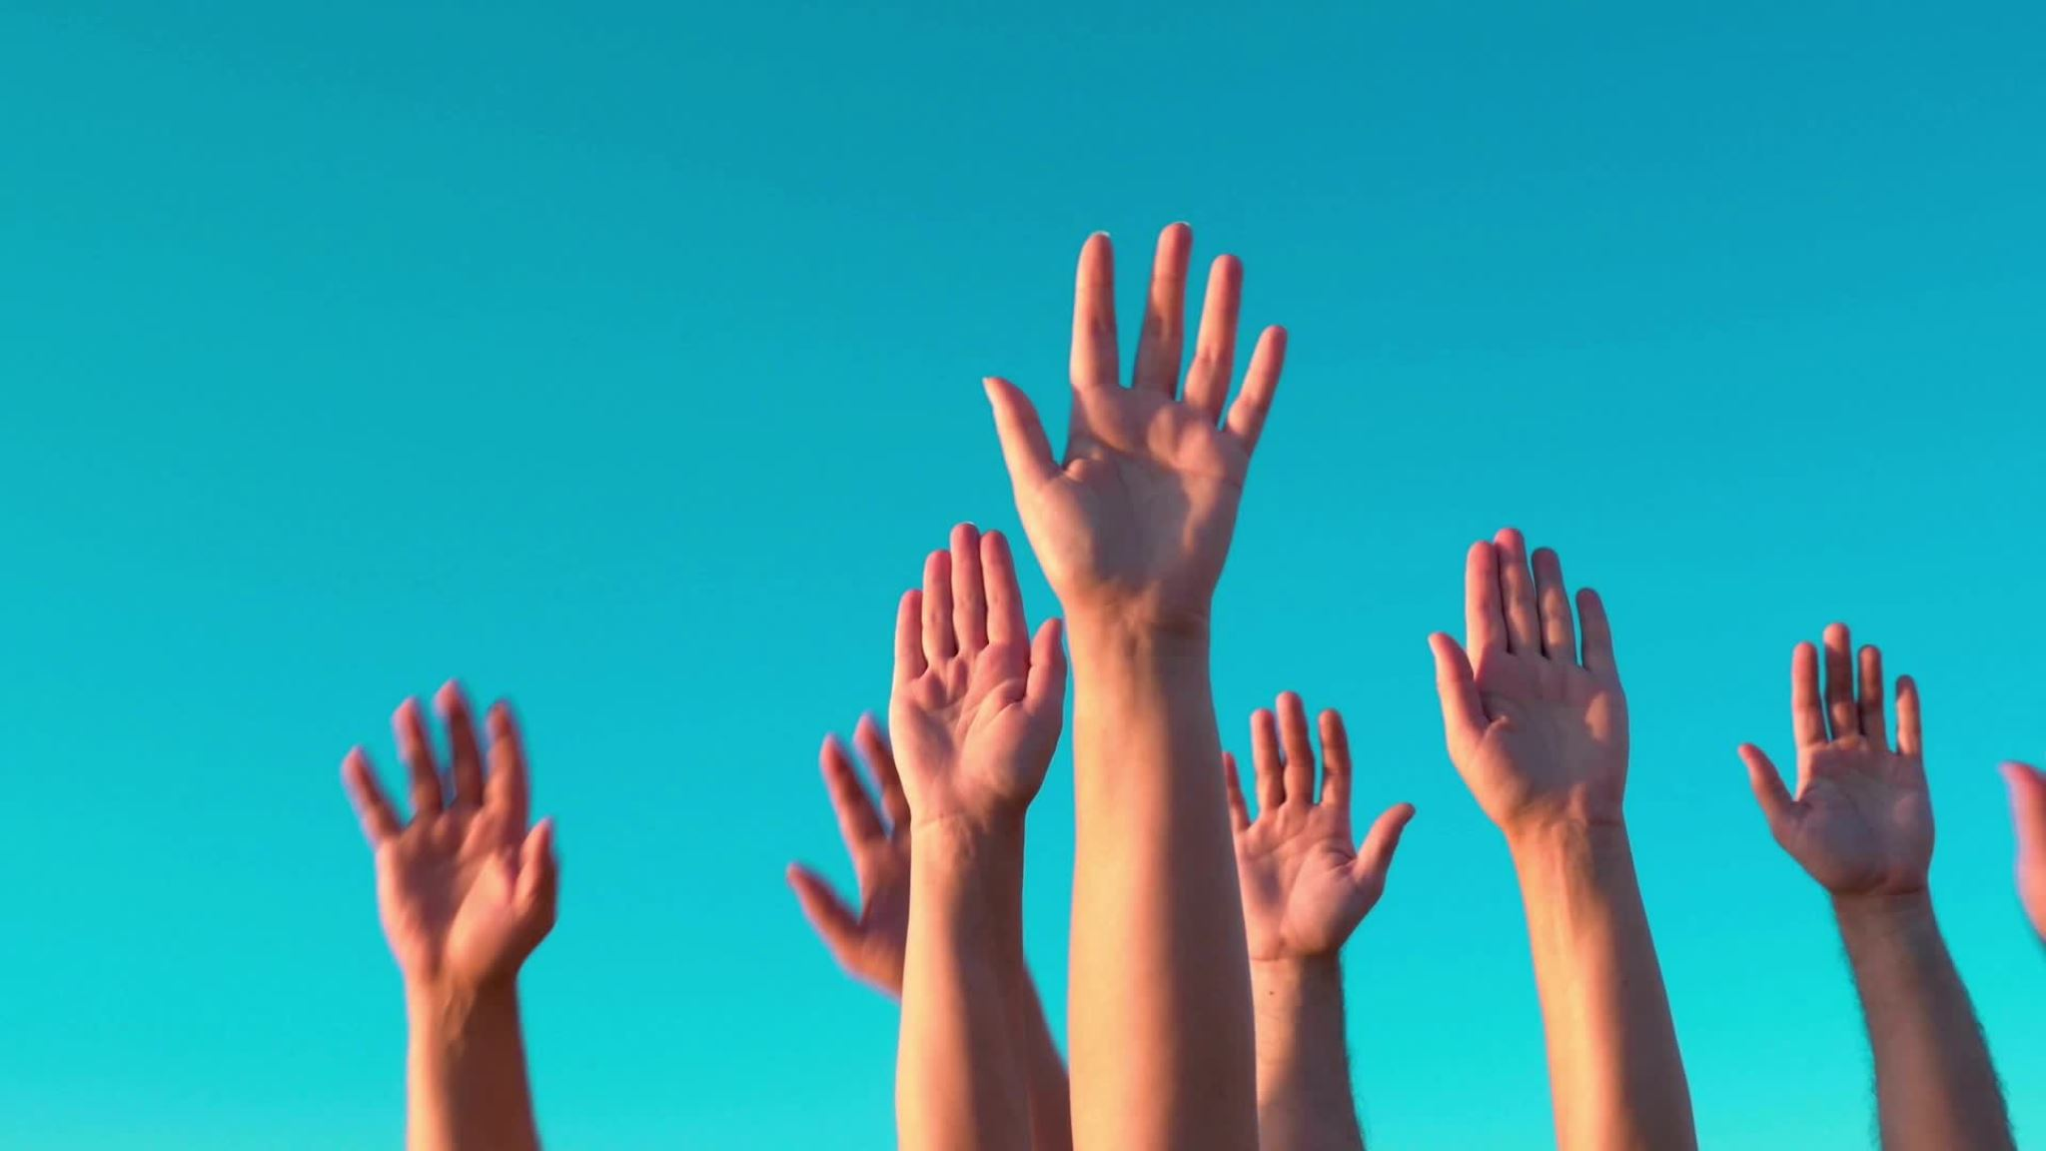
Hand Gesture Recognition Thank You

